Slide 1



A Text Analysis of Research Documents Using NLP
Ankita Kotadia
Data Scientist

Slide 2
Table of Contents
Problem Statement
Data Overview
Text Processing
Dimensionality Reduction
Clustering Techniques
Summarization
Conclusion
Feature Extraction
Clustering Pipeline
Power BI Dashboard

Slide 3
Problem Statement
Challenges
Exponential growth of research publications.
Difficulty for researchers to stay updated.
Manual reading is time-consuming.
Goal
Address the problem of information overload by developing an automated system to cluster research paper abstracts based on their semantic similarities and generate concise summaries for each cluster.
The proposed method employs NLP-based clustering techniques and utilizes pre-trained language models to generate summaries for each cluster.

Slide 4
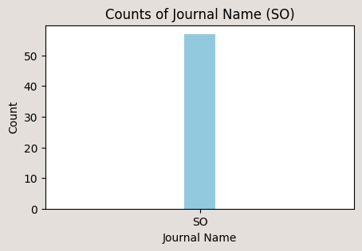
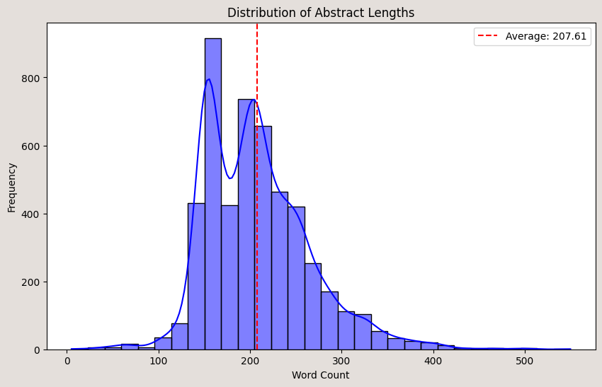
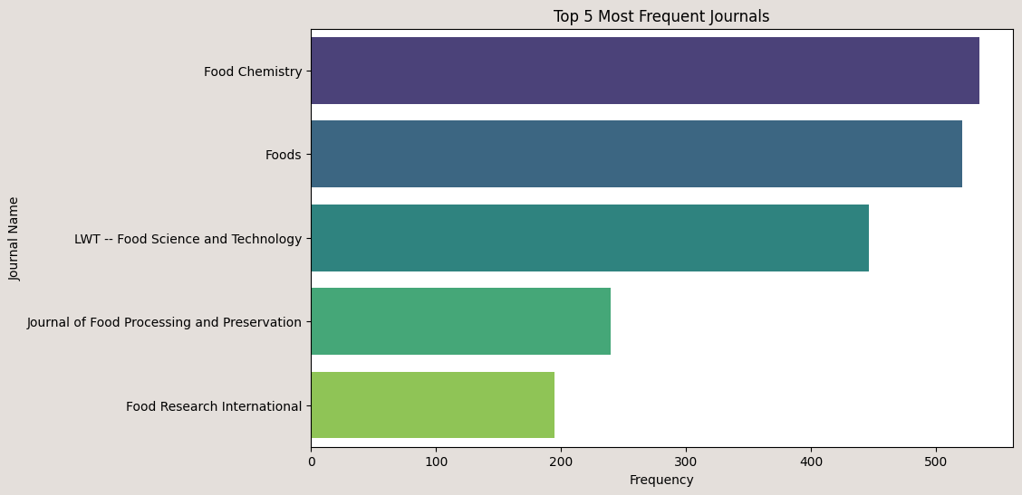
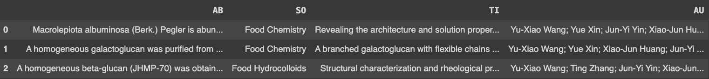
Data Overview
Total Records: 5000
Records After Removing Null Values: 4993

Slide 5



Clustering Pipeline
Text Processing
Embeddings
Dimensionality Reduction
Clustering
Summarizations
BI Dashboard
Data Loading

Slide 6
Text Processing/Cleaning
Lowered all the text data.
Removed unnecessary information such as {‘In this study’, ‘Last sentence of each document’, ‘Shown’, ‘Investigate’} and so on.
Removed special characters except {'<>=%$-/≤≥+*’}
Removed Stopwords.
Maintained 1946 unique numbers for vocabulary richness.
Applied Word Lemmatization to normalize words and that improved clustering performance.
After Processing:
“macrolepiota albuminosa berk pegler abundant active polysaccharide little known structure solution property water-extracted polysaccharide albuminosa mawp purified three fraction structural heterogeneity”

Slide 7
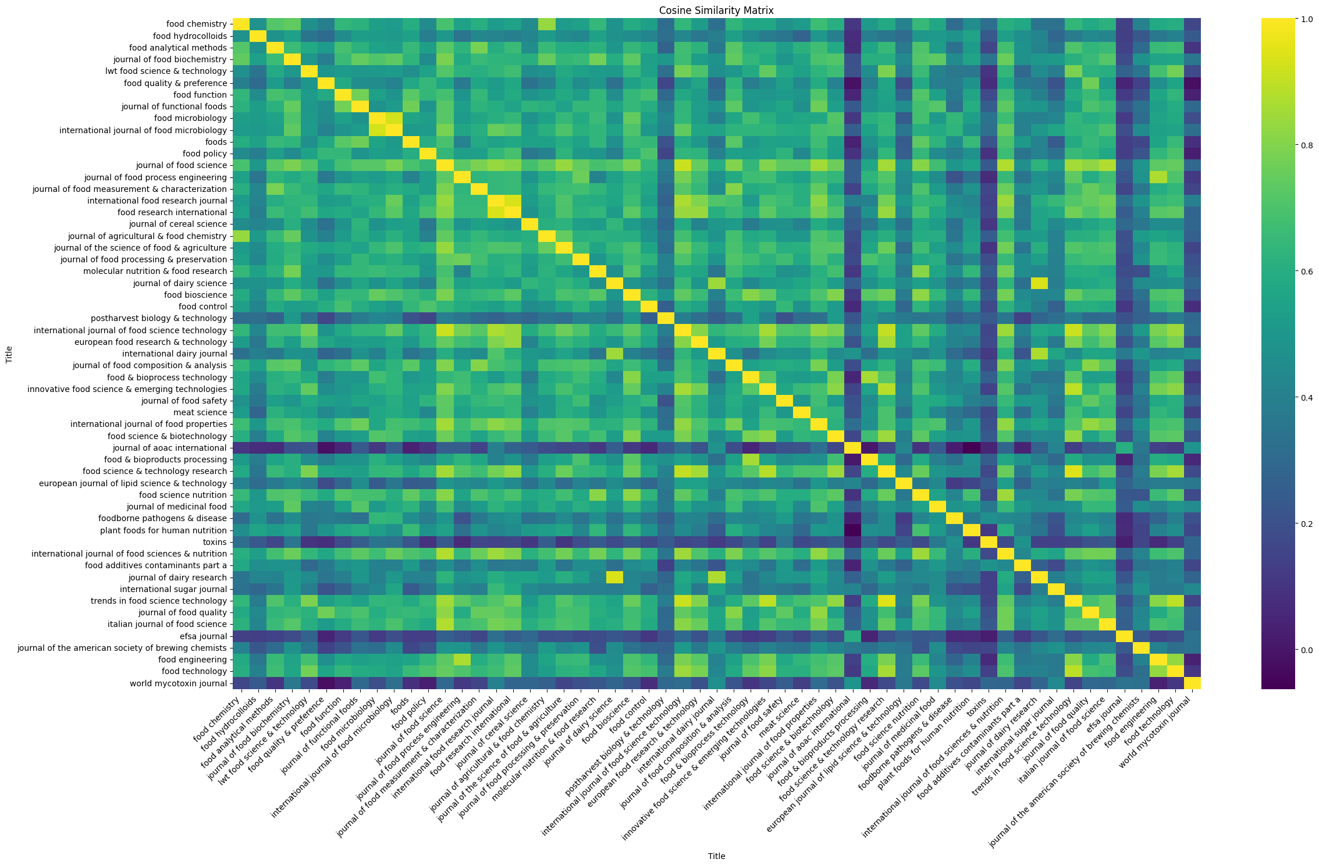
Text Processing: Handling Journal Title Inconsistencies
Challenge:
Journal titles might be categorized differently due to typos or word interchanging.
This leads to titles being considered as new categories, causing inconsistencies.
Solution:
Generated embeddings using Sentence Transformer and using Cosine similarity found similarities between titles to ensure each title is unique.
Ex: Food Microbiology and International Journal of Food Microbiology are same.
>0.90 similarity means both are exact same

Slide 8
Embeddings
TFIDF(ngram_range=(1, 3), max_features=500)
SentenceTransformer(model_name = 'paraphrase-MiniLM-L6-v2’, dimensions=348)
Word2Vec(dimensions=128, window=3, min_words=2)
Doc2Vec(dimensions=128, window=3, min_words=2)
FASTTEXT(dimensions=128, window=3, min_words=2)

Slide 9
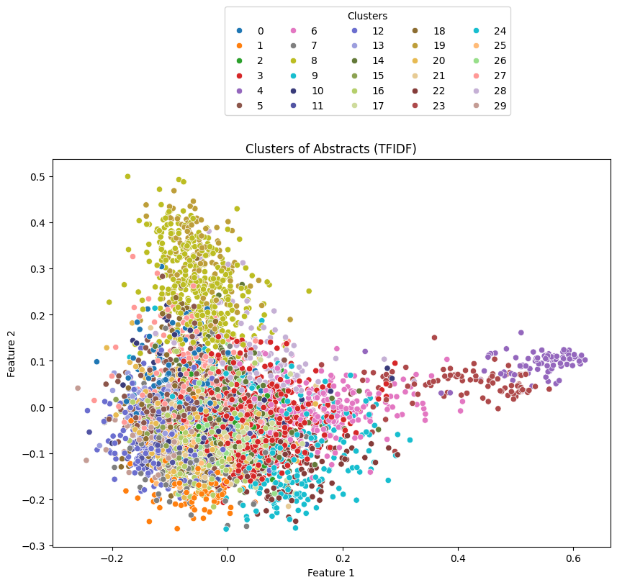
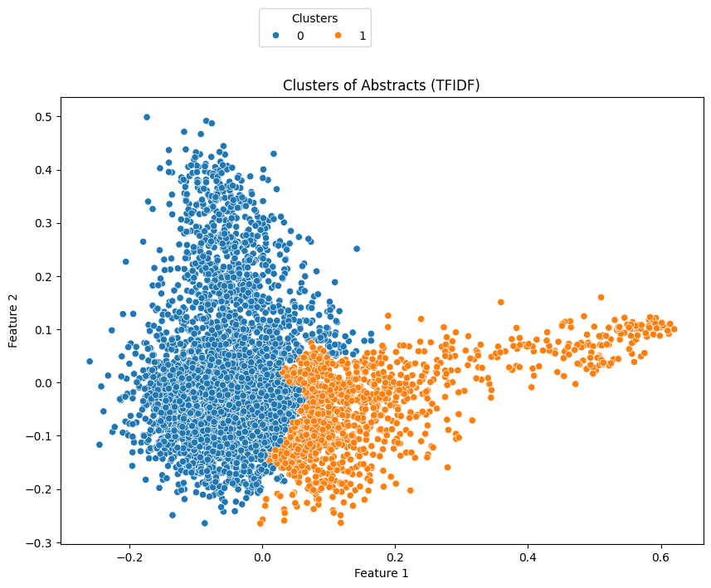
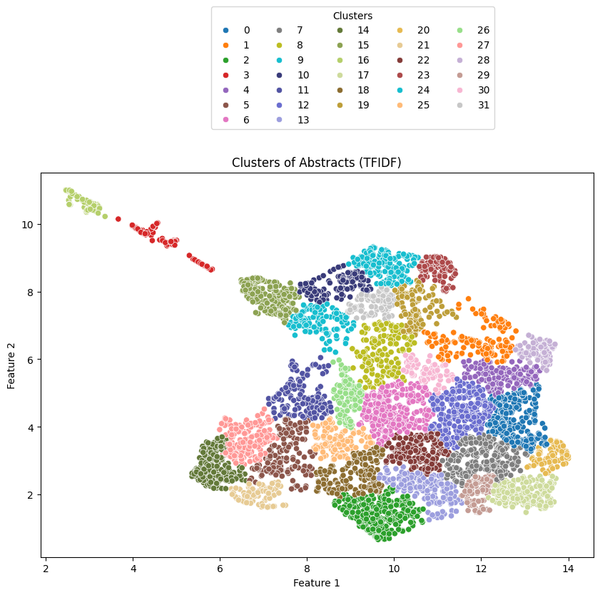
Feature Extraction
Without Dimension Reduction
Max_dim = 500
Min_dim = 128
Clustering Accuracy: 0.01
PCA
N_compenents = 2
Clustering Accuracy: 0.28
UMAP
N_compenents = 2
Clustering Accuracy: 0.44

Slide 10
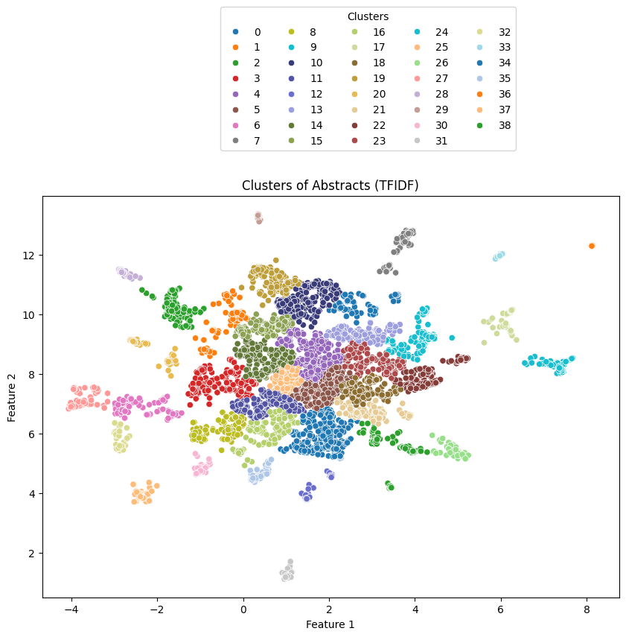
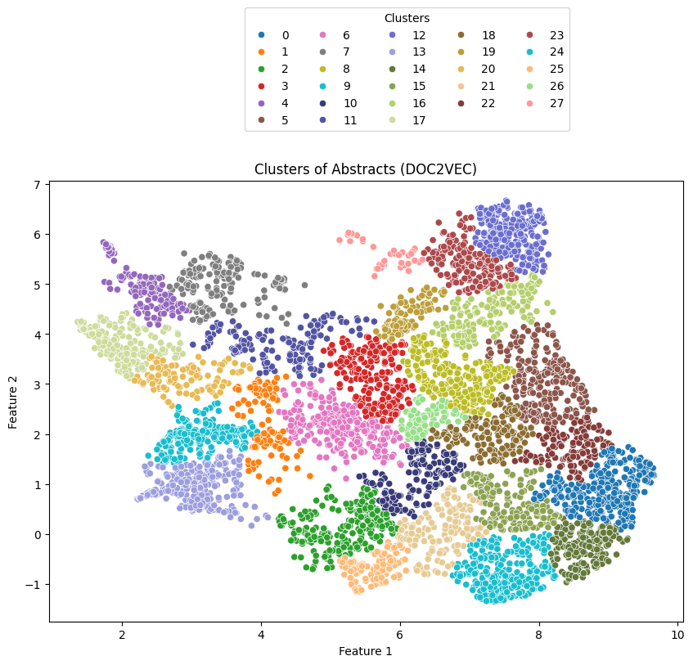

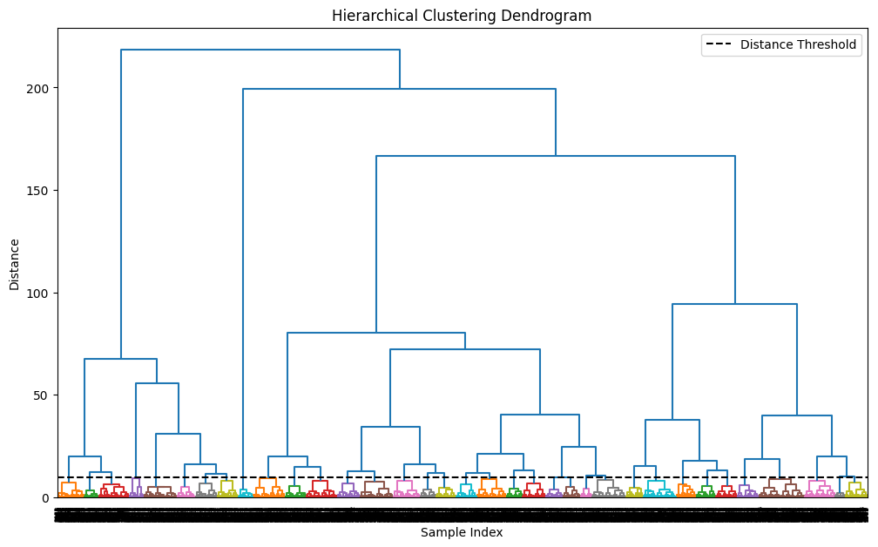
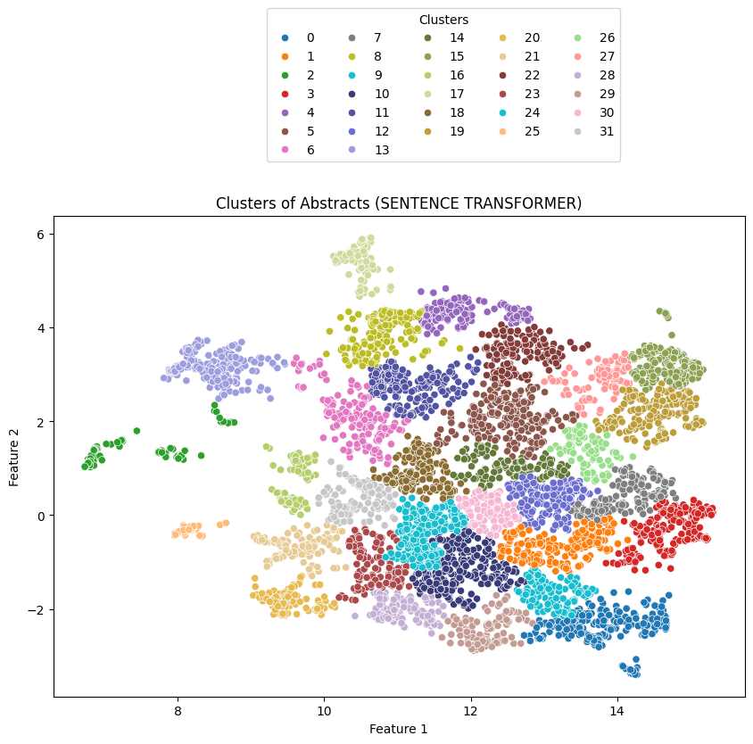
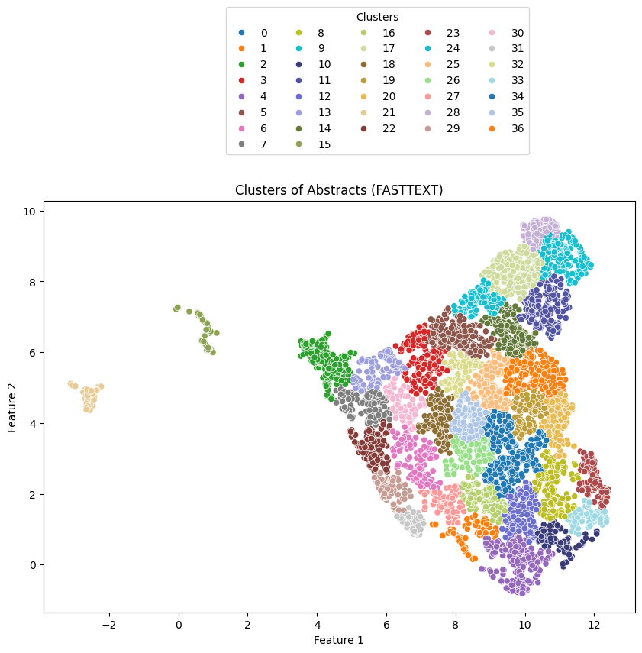
Clustering Algorithms
Performed experimental analysis using various algorithms DBSCAN, HDBSCAN, Affinity Propagation, Spectral, however Agglomerative outperformed all other algorithms.
Agglomerative(linkage=‘ward’, distance=9.5)
Algorithms | Silhouette Score
Sentence Transformer | 0.38
FastText | 0.36
Doc2Vec | 0.34
Word2Vec | 0.33
TFIDF | 0.44

Slide 11
Summarization of Clusters
Challenges:
Each cluster contains an average of 300K words.
No existing algorithms support summarizing such large texts effectively.
Solution:
Created 5 subclusters within each large cluster.
Centroids of subclusters contain meaningful information.
Selected 5 centroid abstracts instead of random data points.
Summarization Method:
Used T5 (Text-to-Text Transfer Transformer) model to generate summary.
Generated summaries from the centroid abstracts.

Slide 12
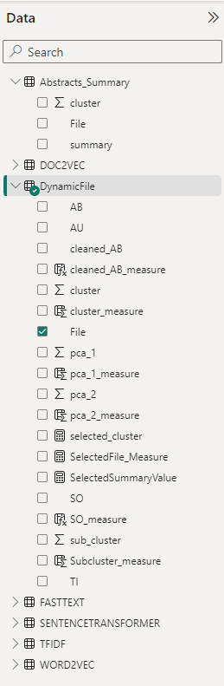
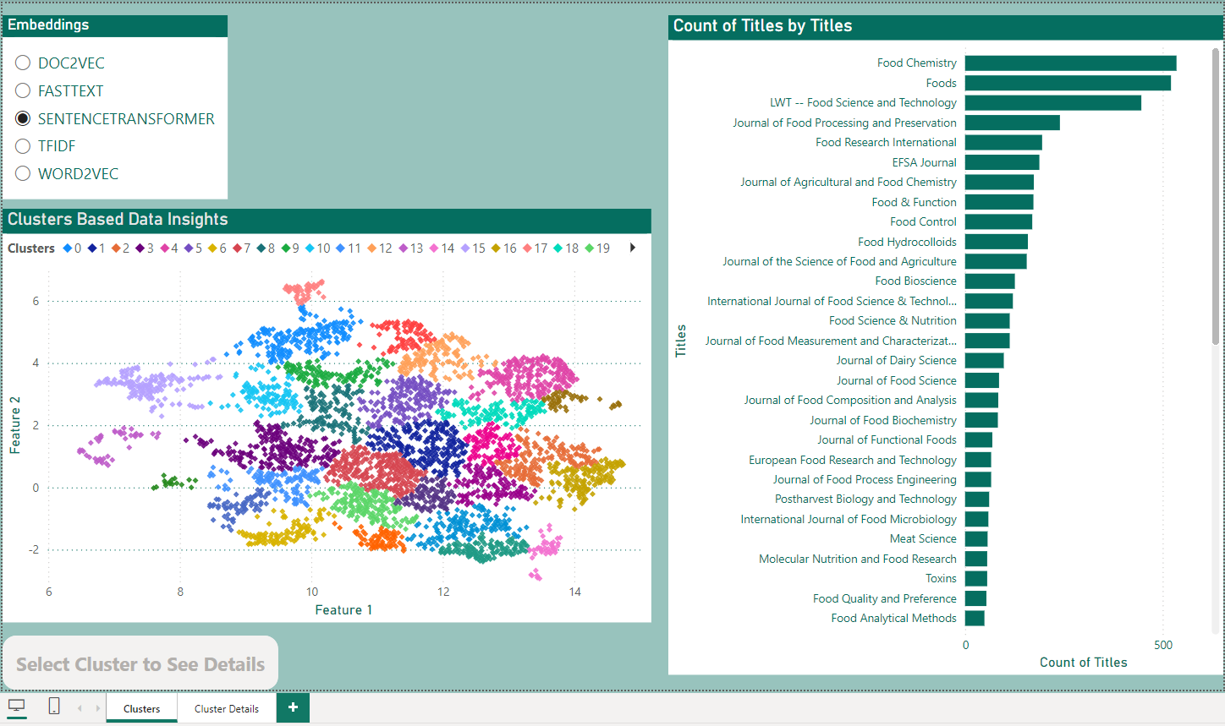
Power BI Dashboard
Fact Table
`
Dynamic Table Filter
`
Measures
Drill Through

Slide 13
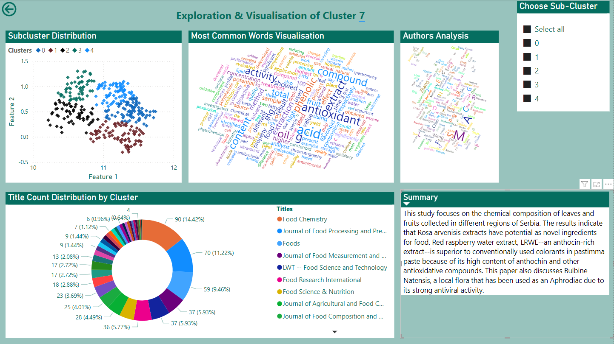
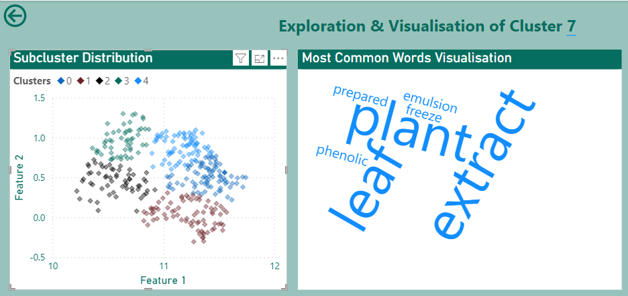
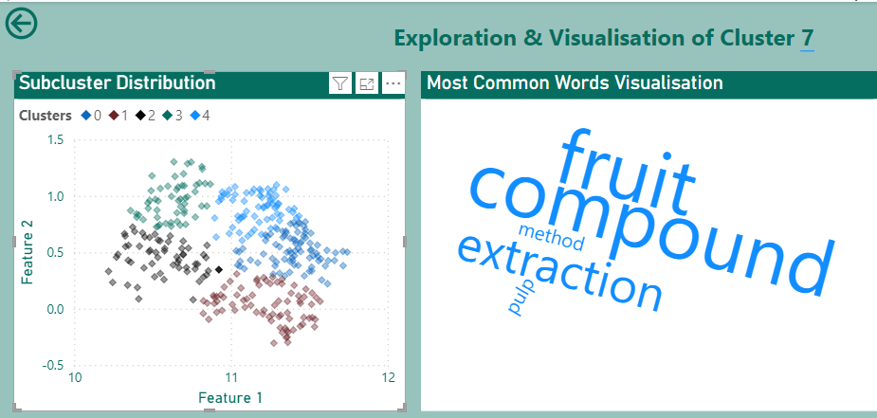
Power BI Dashboard

Slide 14
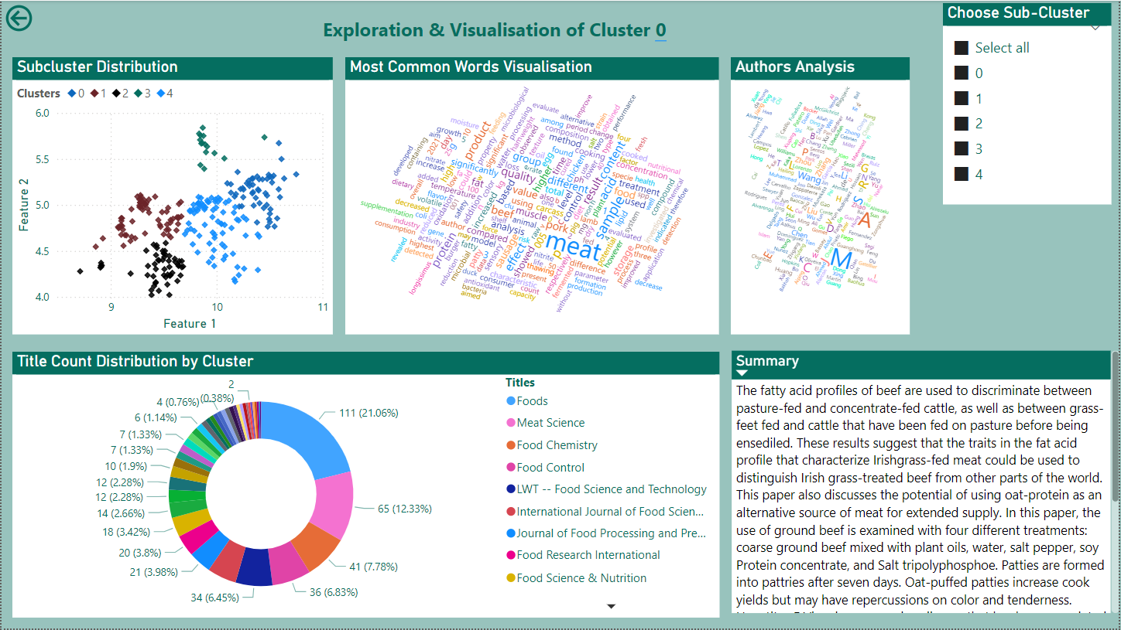

Slide 15

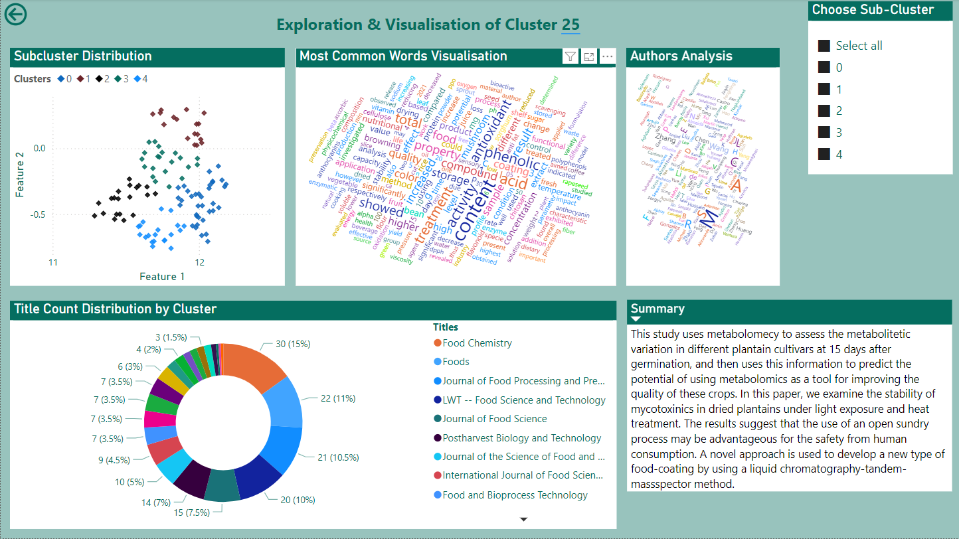

Slide 16
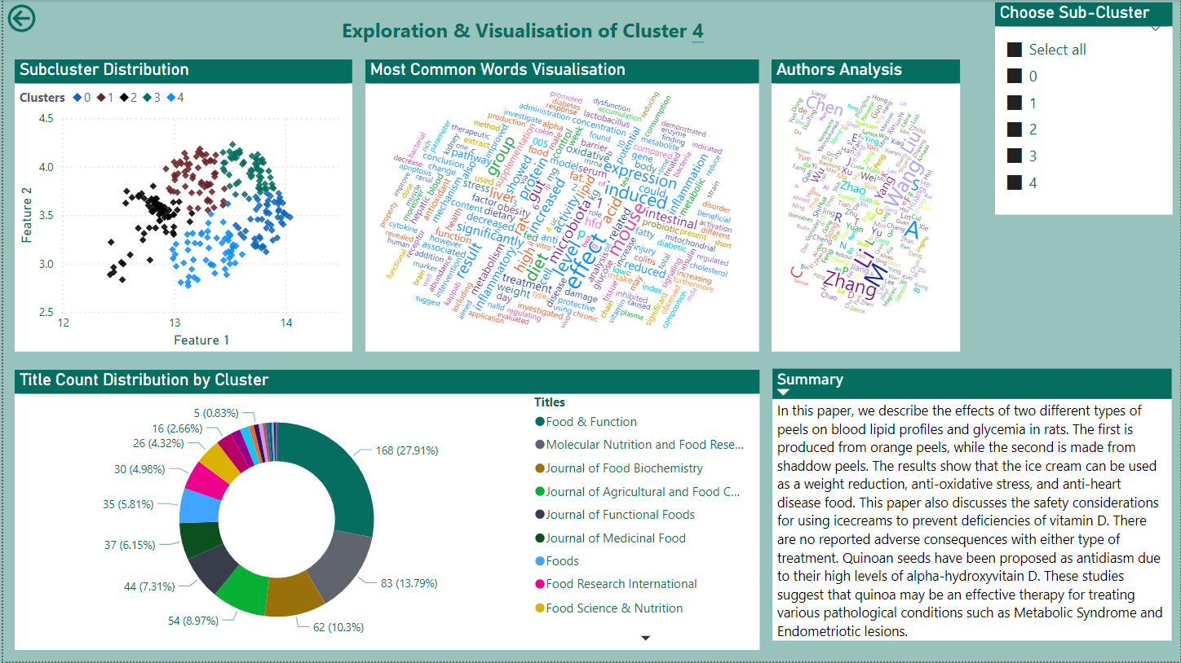

Slide 17

Conclusion
In this project, I leveraged advanced NLP techniques to compare various algorithms and identify the most suitable one for our task, ultimately achieving effective clustering of research abstracts. The results were visualized through an interactive Power BI dashboard, providing researchers with a valuable tool to navigate and synthesize information efficiently.
GitHub

Slide 18

Thank You

